Slide 1
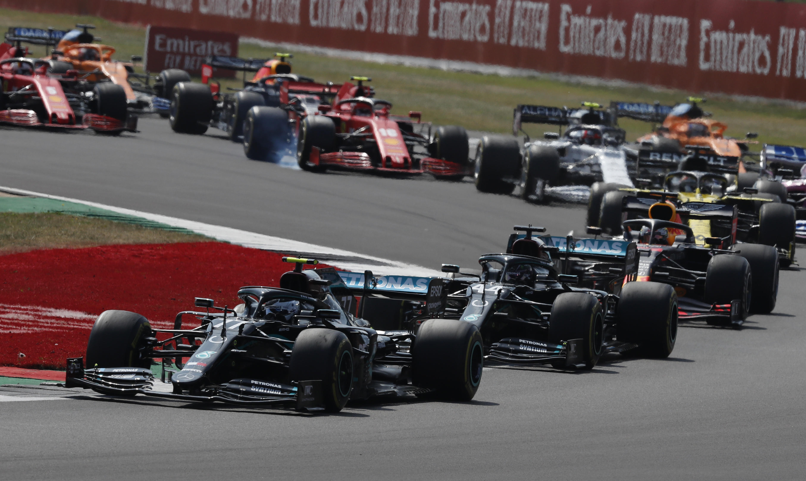
Formula 1 Race Predictor

Slide 2
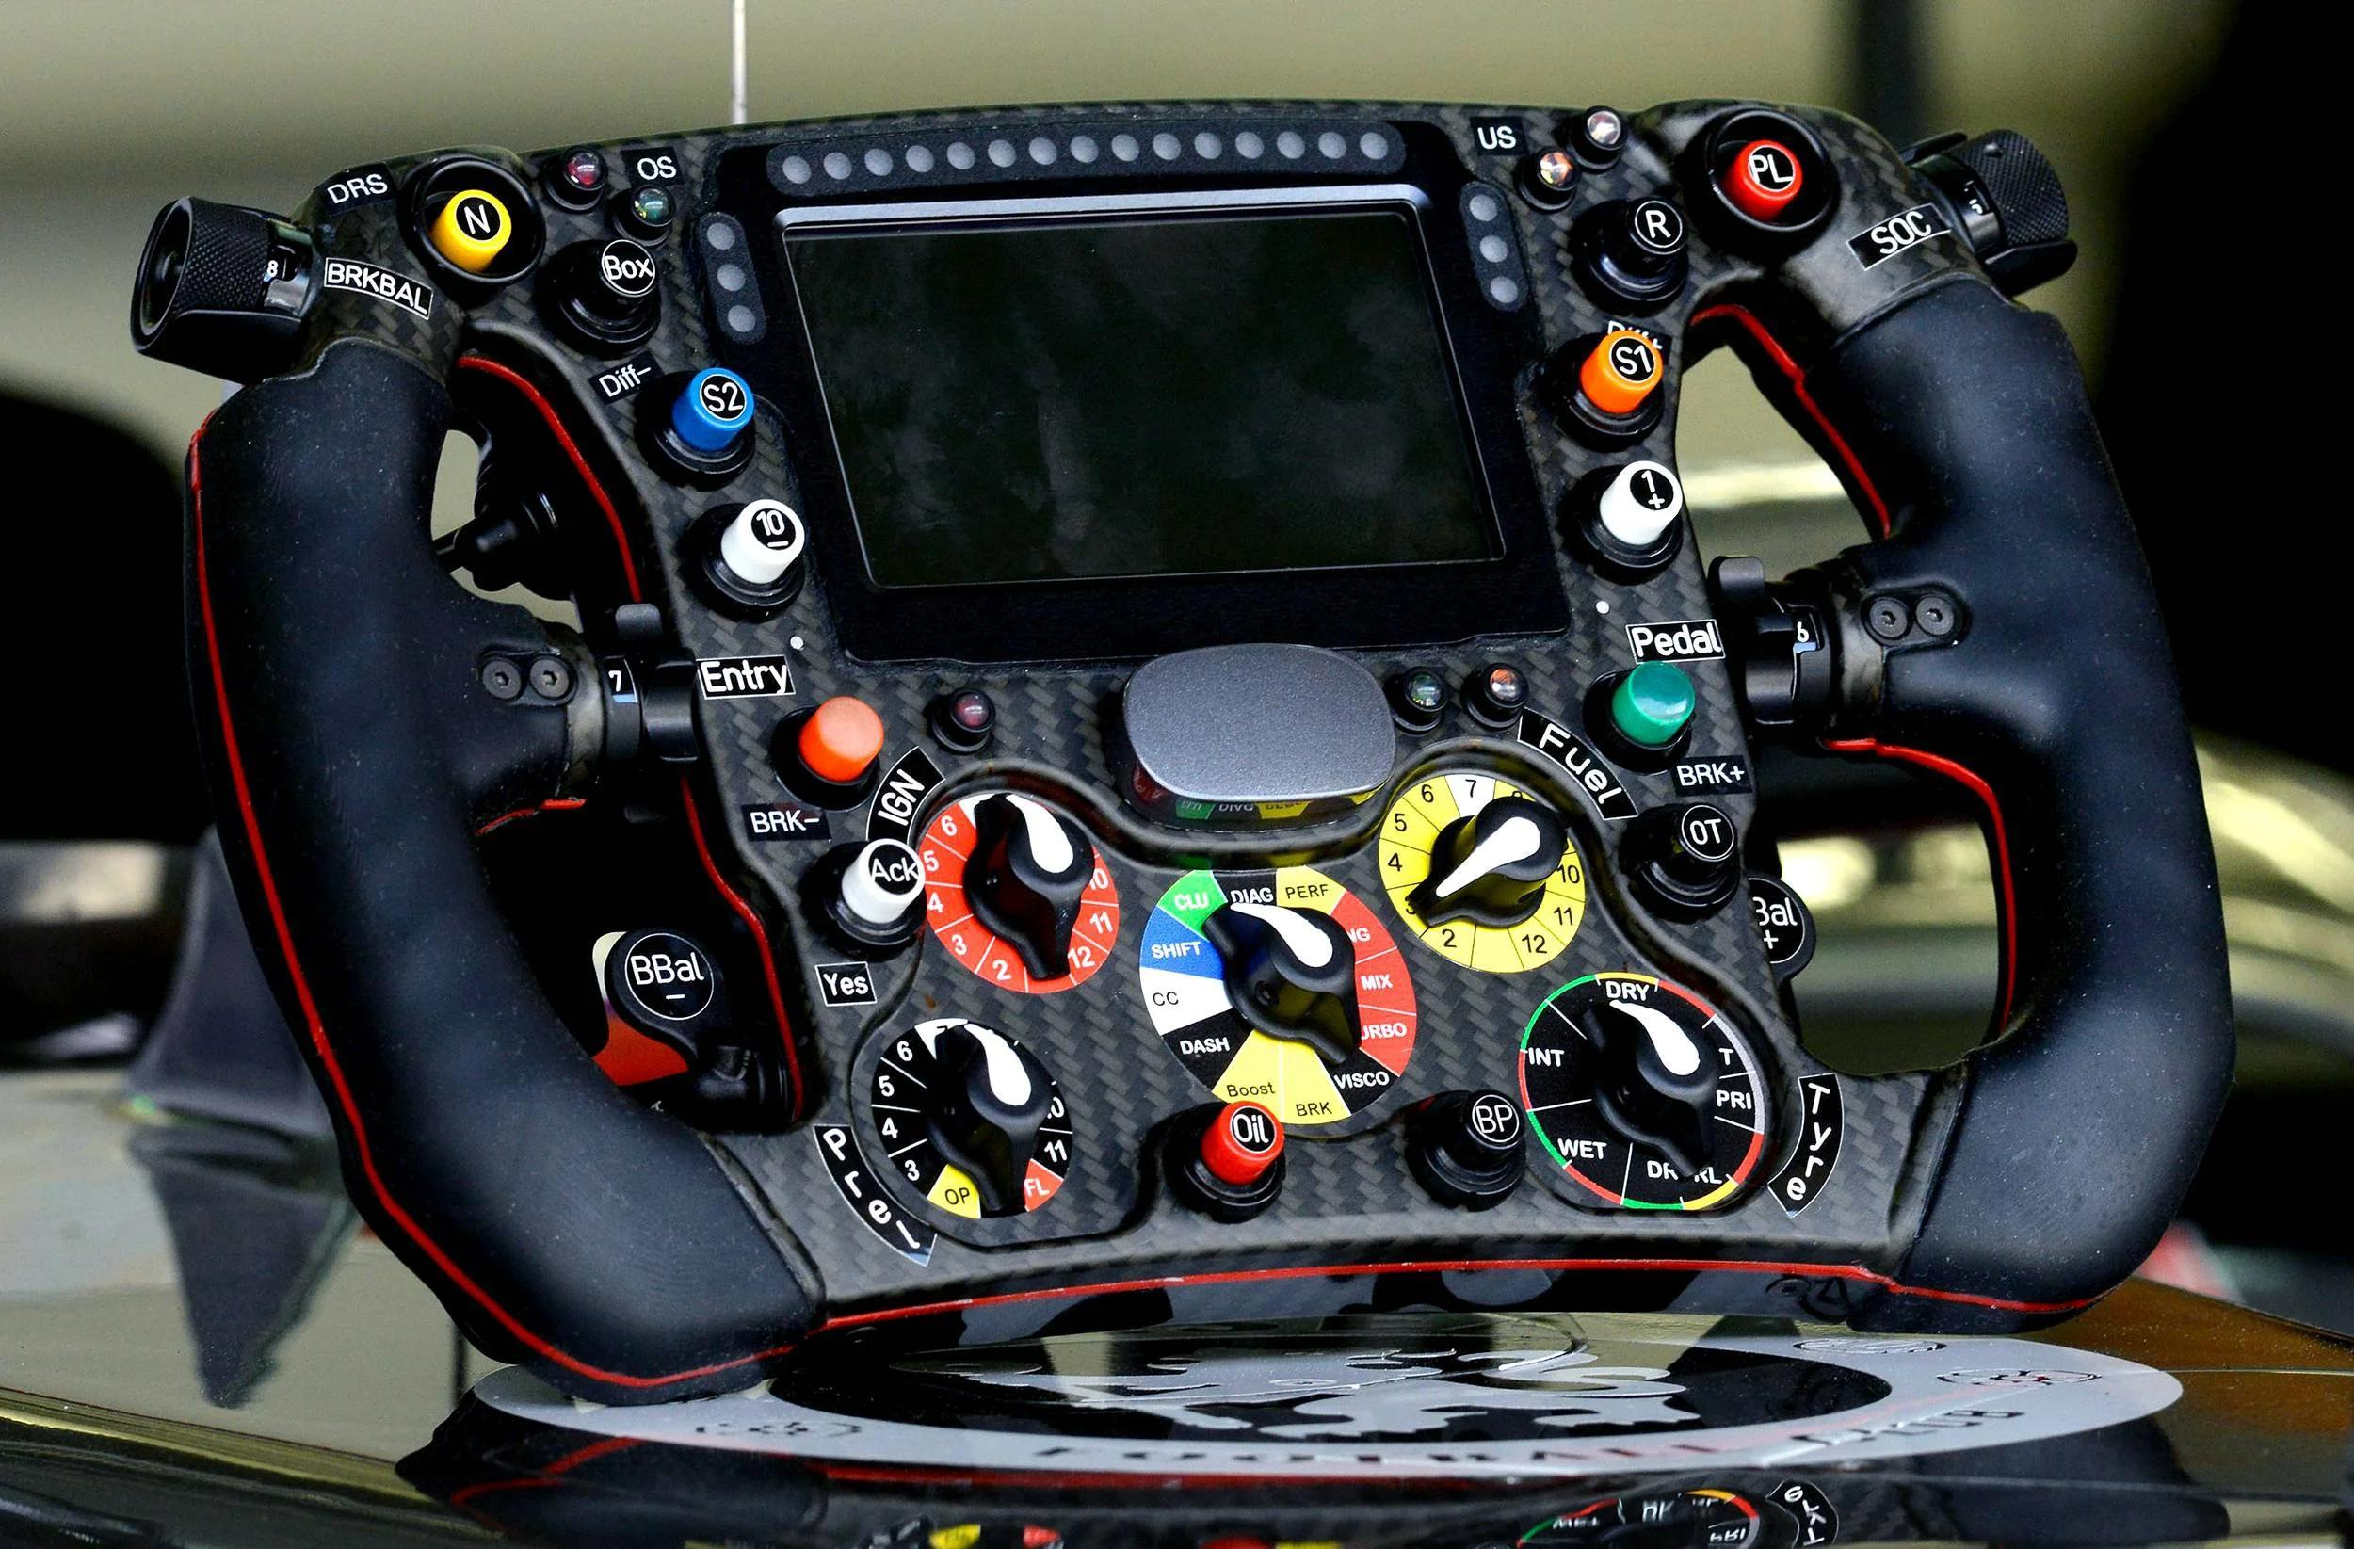
1. Introduction
I'm a big fan of Formula One; it's an incredible sport, so I thought it'd be fun to predict a driver's chances of winning a Grand Prix and compare them to the bookmakers' odds. This project will be divided into three sections:
Data collection
Data analysis
Modelling

Slide 3
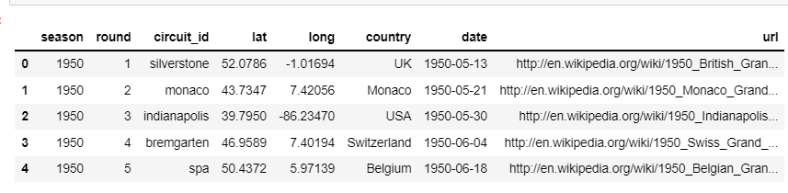
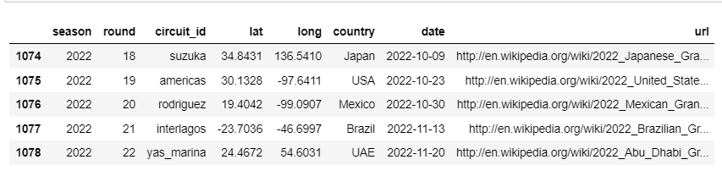
2. Data collection
DataFrame 1: Races
Ergast F1 data repository and the official Formula 1 website, which contains information on all championships and races from 1950 to 2022. Eventually.
My first dataframe includes information on all championships and races from 1950 to 2022, as well as their location and a link to their Wikipedia page.

Slide 4
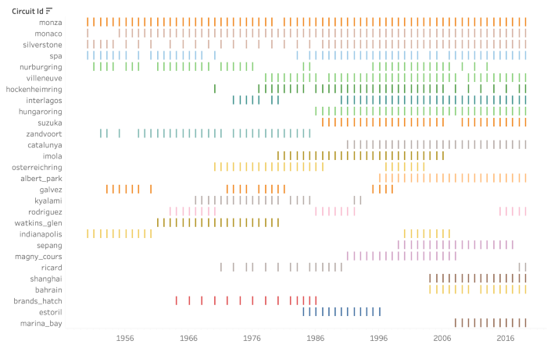
3. Data Analysis
The first drivers' world championship, which consisted of only seven races, was held in 1950 at the British Grand Prix at Silverstone. The number of Grand Prix per season has varied over the years, with the most recent seasons averaging 19 races. The races' locations have also changed over time, depending on the suitability of the track and other financial considerations. Currently, only the Italian and British Grand Prix have not missed a season since 1950

Slide 5
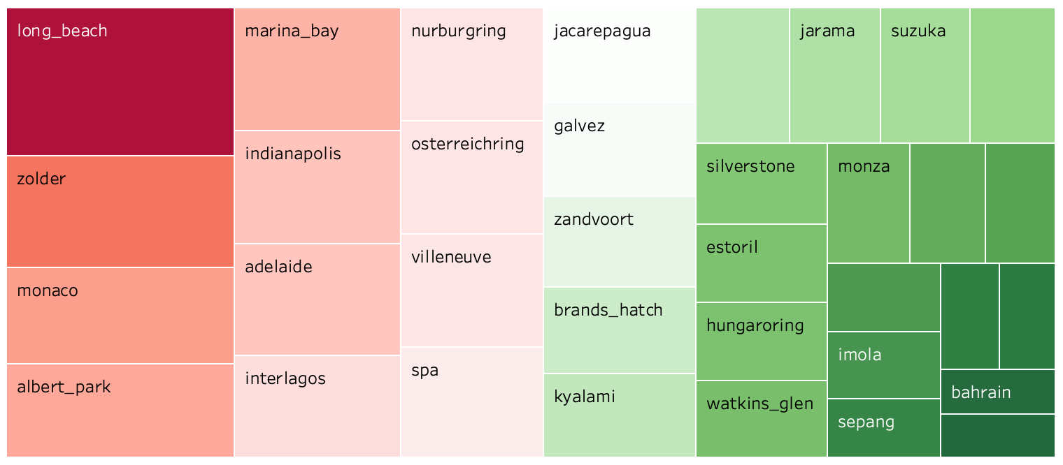
Most dangerous circuits
Some circuit layouts have been redesigned over time to meet stricter safety standards. Most circuits are now designed specifically for competitions, avoiding long and fast straights or dangerous turns. However, some races are still held on street circuits, such as the Monaco Grand Prix, which is still used primarily for its fame and history, despite failing to meet the most recent strict regulations. The tree-map below depicts some of the most popular tracks based on the number of incidents or collisions.

Slide 6
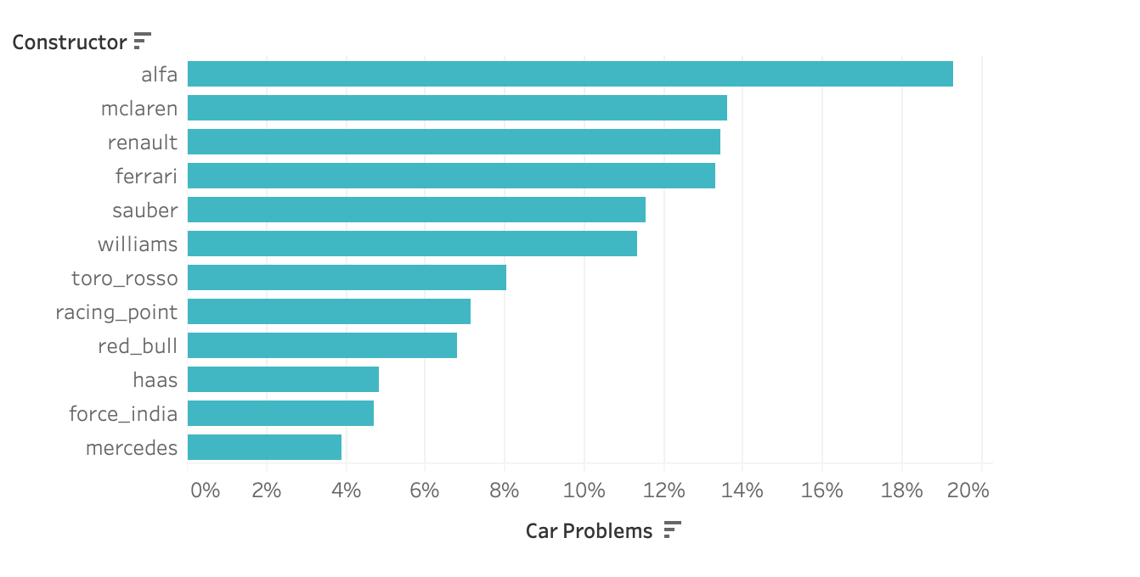
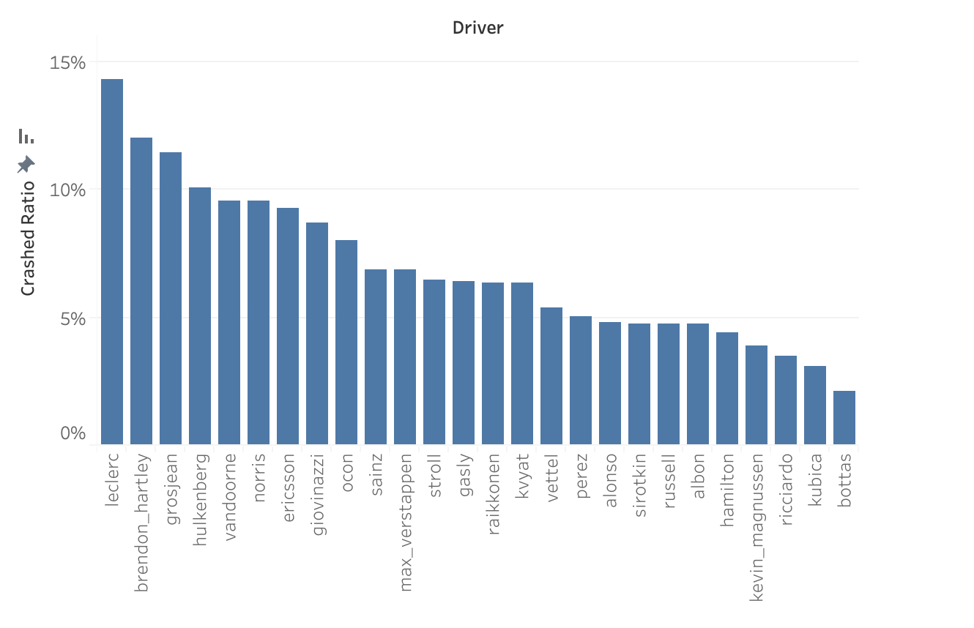
Which teams had more car failures?
The bar chart shows which teams had the most car problems in recent seasons, such as engine failures, brake failures, suspension issues, or transmission problems.
Who is more likely to crash?
Because Formula 1 cars can reach top speeds of 375 km/h (233 mph), crashes can end the race for the drivers. The chart below depicts the crash ratio of some of the drivers who raced in the previous two seasons.

Slide 7
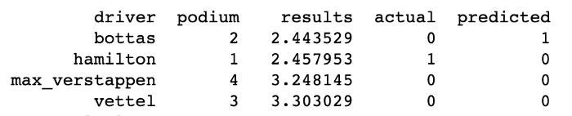
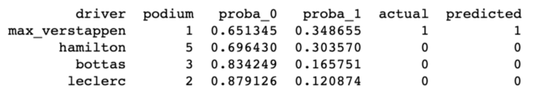
4. Modelling
My final dataframe includes information of races, results, weather, driver and team standings and qualifying times from 1983 to 2022.
Because I want to predict who will finish first on the podium at each race in 2022, I can treat the target variable as a regression or a classification.
When calculating a regression's precision score, I sort my predicted results in ascending order and assign the lowest value as the race winner. Finally, I compute the precision score between the actual and predicted values (mapped 1 and 0) for each race in 2012, and repeat for each race in 2012, until I obtain the percentage of correctly predicted races for that season.
In a classification problem the target is mapped 0 and 1 (winner) prior to modelling so, so when I look at the predicted values, I may have more than one winner or no winner at all depending on the predicted probabilities. Because my algorithm isn't smart enough to understand that I only need one winner for each race, I created a different scoring function for classification that ranks each driver's chances of winning the race. I sort the probabilities from highest to lowest and assign the highest probability driver to win the race.

Slide 8
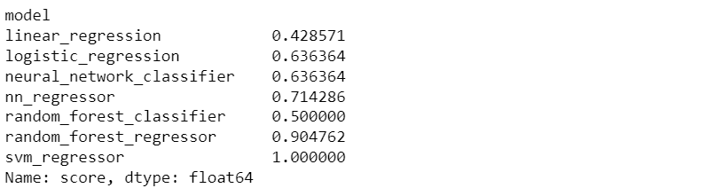
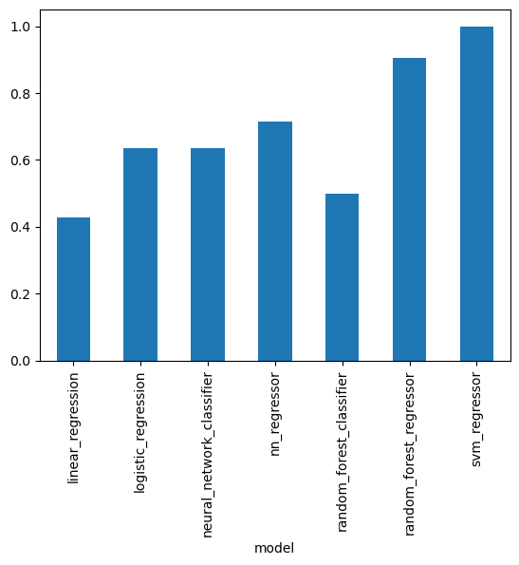
TRAIN — TEST SPLIT: the train set contains all races from 1983 to 2021 inclusive. The test set consists of all 21 races in the season of 2022.
Findings
Classification with Logistic Regression and Neural Network Classifier seem to return the relevant scores, correctly predicting the winner for % of the races in 2022, which corresponds to 15/22 races.

Slide 9
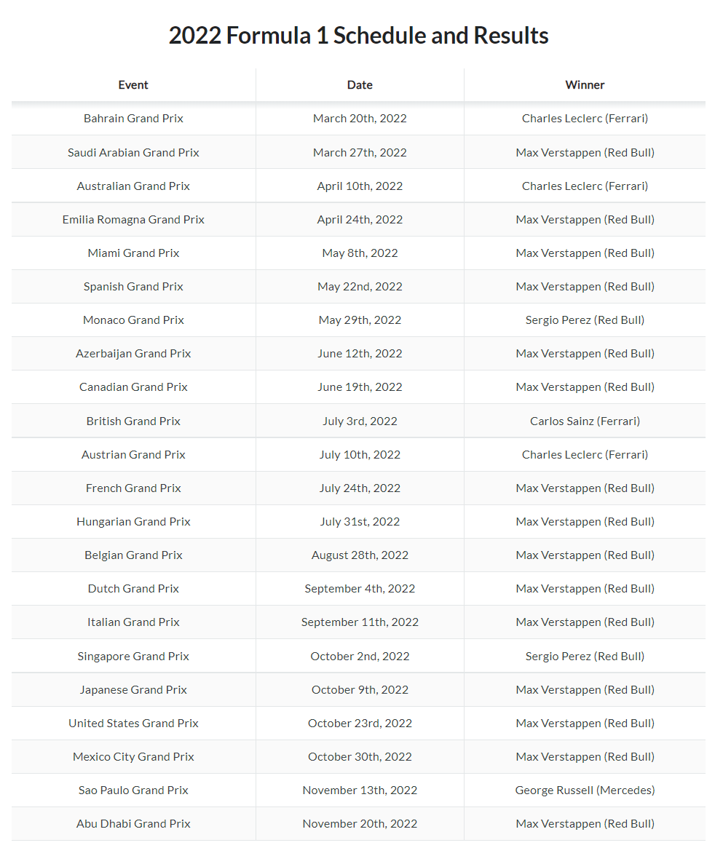

Slide 10
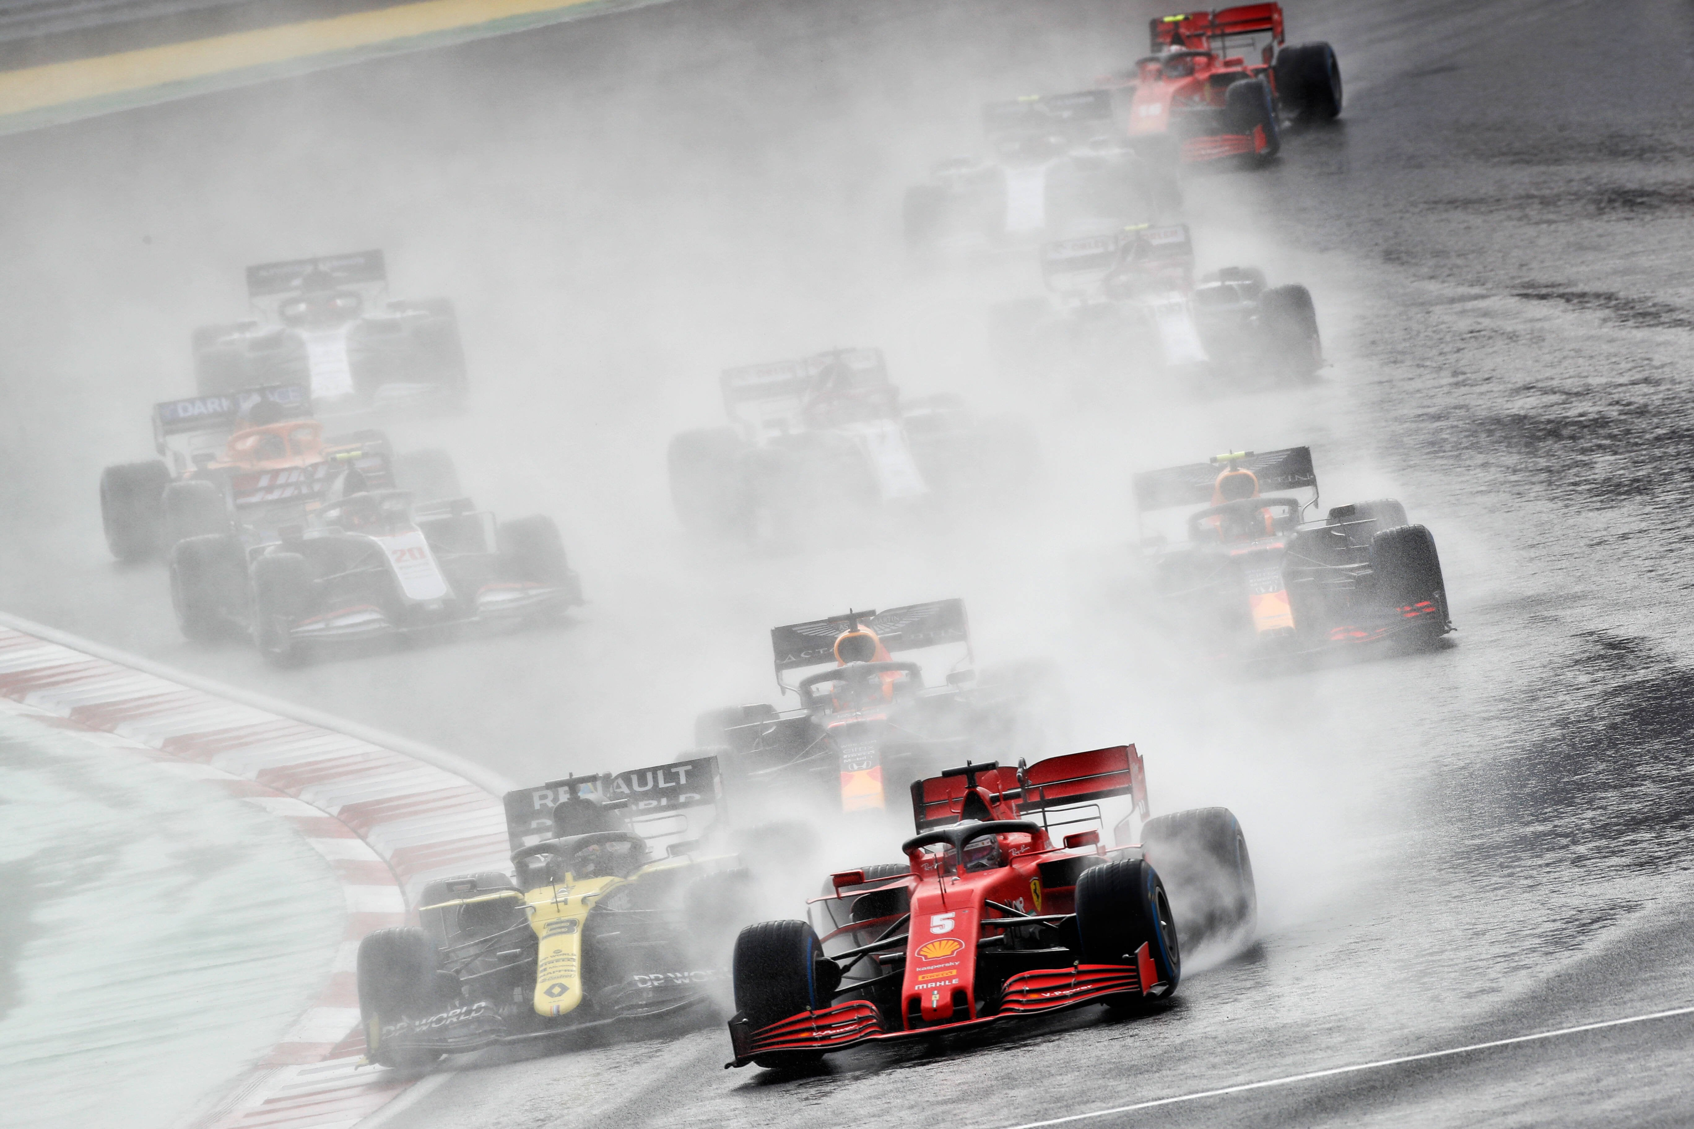
Thank You

